Slide 1

Introduction to Clustering with K-Means Algorithm
Understanding and implementing K-Means clustering algorithms for data segmentation and pattern recognition in large datasets.

Slide 2
Contents
01
02
What is Cluster Analysis?
K-Means Clustering-Overview
03
04
K Means Algorithm
Distance Measures
05
06
K Means Method-Computation
Evaluation Metrics

Slide 3
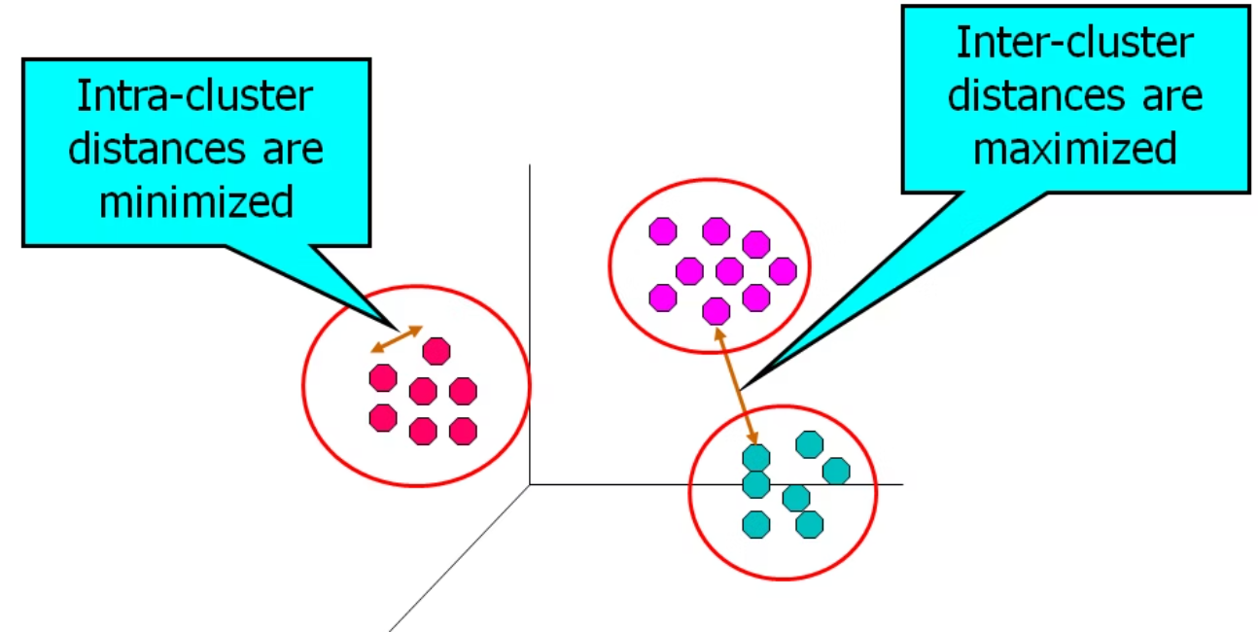
What is Cluster Analysis?
Cluster analysis represents a class of statistical techniques designed to classify objects or cases into relatively homogeneous groups called clusters. This unsupervised learning method organizes data without predefined labels.
Key characteristics of clusters include:
High internal similarity among observations within the same cluster
Clear dissimilarity from objects in other clusters
Natural groupings that emerge from the data structure
No prior knowledge of group membership required

Slide 4
K-Means Clustering Overview
Popular Method
One of the most widely used non-hierarchical clustering approaches in data science
Large Dataset Capability
Particularly suitable for analyzing large datasets in BFSI and retail domains for customer segmentation
Predefined K
Requires knowing the number of clusters (k) in advance, though solutions can be evaluated across different k values
K-Means clustering works by partitioning n observations into k clusters, where each observation belongs to the cluster with the nearest mean. The algorithm iteratively refines cluster assignments until convergence is achieved.

Slide 5
K-Means Implementation Steps
Define K
Determine the optimal number of clusters for your dataset
Choose Distance Measure
Select appropriate similarity metric (Euclidean, Manhattan, etc.)
Select Initial Seeds
Establish starting centroids for each cluster
Execute Algorithm
Assign observations and update centroids iteratively
Evaluate Output
Assess cluster quality using R-squared and contribution metrics

Slide 6
Distance Measures: Foundations of Similarity
Clustering algorithms rely on mathematical measures to assess the similarity between pairs of observations or clusters. The choice of distance measure significantly impacts the final cluster solution.
Manhattan Distance
Sum of absolute differences across all variables:
d(x,y) = |a₁-b₁| + |a₂-b₂| + ... + |aₚ-bₚ|
Useful when dealing with grid-like path structures
Chebyshev Distance
Maximum absolute difference across variables: d(x,y) = Max(|aᵢ-bᵢ|)
Focuses on the dimension with greatest difference

Slide 7
Euclidean Distance: The Standard Metric
Squared Euclidean Distance
The sum of squared differences between values of each variable. Taking the square root yields the Euclidean Distance.
Object | X1 | X2 |  |  | XP
1 | a₁ | a₂ |  |  | a_{p}
2 | b₁ | b₂ |  |  | b_{p}
Euclidean distance is the most widely used distance measure in cluster analysis due to its intuitive geometric interpretation.

Slide 8
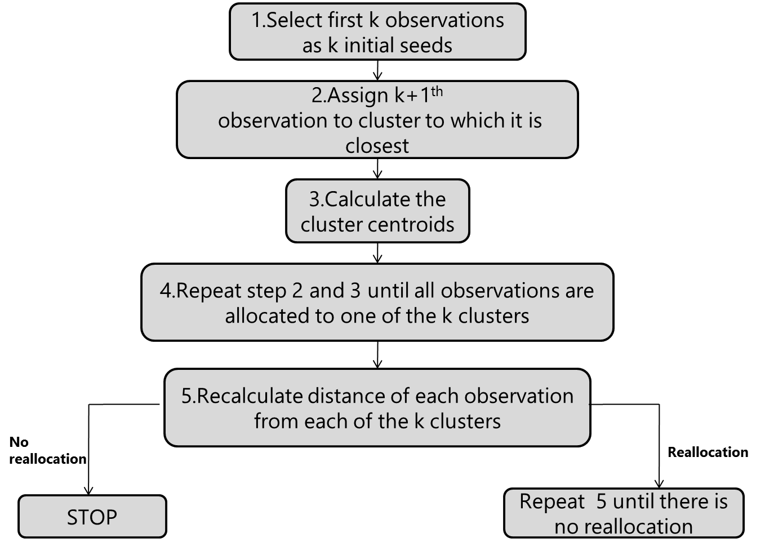
K-Means Algorithm Flowchart
The algorithm iteratively assigns observations to the nearest cluster centroid, then recalculates centroids based on current assignments. This process continues until cluster membership stabilizes.

Slide 9
Choosing Initial Seeds
The selection of initial cluster centroids (seeds) can influence the final clustering solution. Several methods exist for determining starting points:
K-Random Observations
Randomly select k observations from the dataset as initial centroids. Simple but may yield variable results across runs.
Last K Observations
Similar to first k, but uses the final k observations in the dataset.
First K Observations
Use the first k observations in the dataset. Quick but potentially biased if data has inherent ordering.
Partition-Based Initialization
Randomly partition data into k groups, then calculate the mean or median of each partition as initial seeds. Often produces more stable results.

Slide 10
Case Study: Town Insurance Data
Dataset Overview
We'll demonstrate K-Means clustering using insurance data from eight towns, with three key variables measuring insurance metrics.
Variable Definitions
Variable | Description | Type
Town | Town identifier | Character
x1 | Loss Ratio | Numeric (positive)
x2 | Premium Rates | Numeric (positive)
x3 | Number of Policies | Numeric (positive)
TOWN | x1 | x2 | x3
A | 1.06 | 9.2 | 151
B | 0.89 | 10.3 | 202
C | 1.43 | 15.4 | 113
D | 1.02 | 11.2 | 168
E | 1.49 | 8.8 | 192
F | 1.32 | 13.5 | 111
G | 1.22 | 12.2 | 175
H | 1.1 | 9.2 | 245
Observations

Slide 11
Iteration 1: Initial Setup
Complete Dataset (K=2)
Step 1: Initial Seeds
We begin by selecting Towns A and B as our initial cluster centroids.
These initial seeds serve as the starting points for our clustering algorithm. All subsequent towns will be assigned based on their distance to these centroids.
TOWN | x1 | x2 | x3
A | 1.06 | 9.2 | 151
B | 0.89 | 10.3 | 202
C | 1.43 | 15.4 | 113
D | 1.02 | 11.2 | 168
E | 1.49 | 8.8 | 192
F | 1.32 | 13.5 | 111
G | 1.22 | 12.2 | 175
H | 1.10 | 9.2 | 245
TOWN | x1 | x2 | x3
A | 1.06 | 9.2 | 151
B | 0.89 | 10.3 | 202

Slide 12
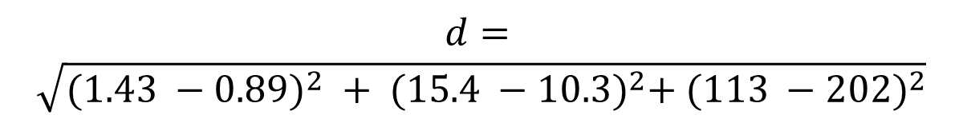
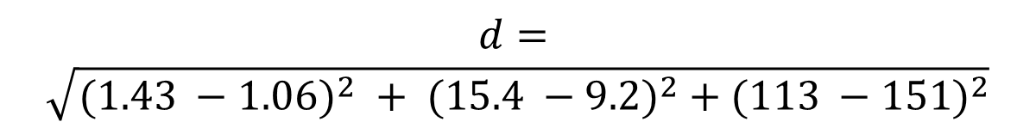
Iteration 1: Assigning Town C
Step 2: Distance Calculation
Distance to Cluster 1 (Town A)
Distance = 38.50
Distance to Cluster 2 (Town B)
Distance = 89.15
$$d=$$
$$\sqrt{{(1.43 −1.06)}^{2} + {(15.4 −9.2)}^{2} + {(113 −151)}^{2}}$$
$$d=$$
$$\sqrt{{(1.43 −0.89)}^{2} + {(15.4 −10.3)}^{2}+ {(113 −202)}^{2}}$$
CLUSTER | MEMBERS | x1 | x2 | x3
1 | A,C | 1.245 | 12.3 | 132
2 | B | 0.89 | 10.3 | 202
Decision: Since 38.50 < 89.15, Town C is assigned to Cluster 1 with Town A. The cluster centroid is updated by calculating the mean of Towns A and C.

Slide 13
Iteration 1: Progressive Assignments
1. Town D Assignment
Distance to Cluster 1: 36.018 | Distance to Cluster 2: 34.012
Assigned to Cluster 2 (B)
2. Town E Assignment
Distance to Cluster 1: 60.102 | Distance to Cluster 2: 7.286
Assigned to Cluster 2 (B, D)
3. Town F Assignment
Distance to Cluster 1: 21.034 | Distance to Cluster 2: 76.409
Assigned to Cluster 1 (A, C)
CLUSTER | MEMBERS | x1 | x2 | x3
1 | A,C | 1.245 | 12.3 | 132
2 | B,D | 0.955 | 10.75 | 185
CLUSTER | MEMBERS | x1 | x2 | x3
1 | A,C | 1.245 | 12.3 | 132
2 | B,D,E | 1.133333 | 10.1 | 187.3333
CLUSTER | MEMBERS | x1 | x2 | x3
1 | A,C,F | 1.27 | 12.7 | 125
2 | B,D,E | 1.133333 | 10.1 | 187.3333

Slide 14
Iteration 1: Final Assignments
Town G Assignment
Distance to Cluster 1: 50.003 | Distance to Cluster 2: 12.511
Assigned to Cluster 2 (B, D, E)
Town H Assignment
Distance to Cluster 1: 120.05 | Distance to Cluster 2: 60.767
Assigned to Cluster 2 (B, D, E, G)
CLUSTER | MEMBERS | x1 | x2 | x3
1 | A,C,F | 1.27 | 12.7 | 125
2 | B,D,E,G | 1.155 | 10.625 | 184.25
CLUSTER | MEMBERS | x1 | x2 | x3
1 | A,C,F | 1.27 | 12.7 | 125
2 | B,D,E,G,H | 1.144 | 10.34 | 196.4
All towns have now been assigned to clusters. We proceed to Iteration 2 to verify cluster membership stability and ensure convergence.

Slide 15
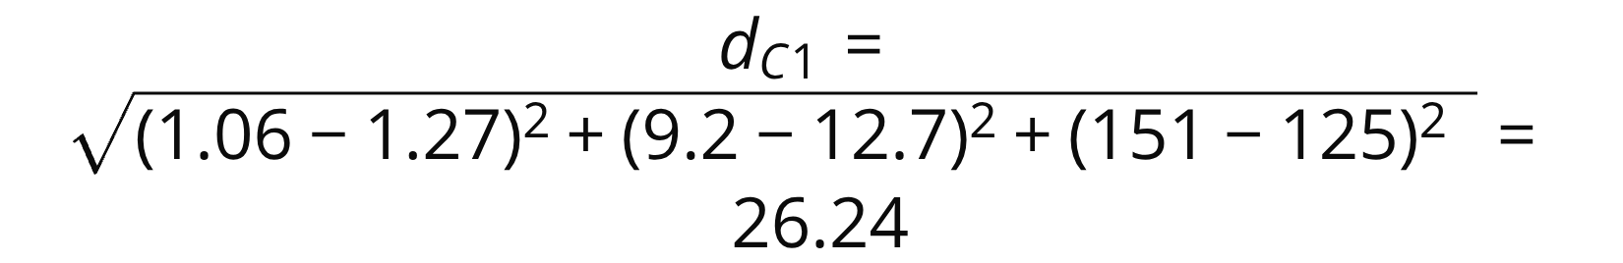
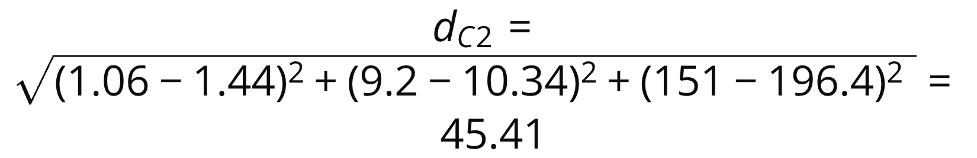
Iteration 2: Verification Phase
Updated Initial Seeds
The cluster centroids from Iteration 1 become the initial seeds for Iteration 2:
Cluster 1: Towns A, C, F
Cluster 2: Towns B, D, E, G, H
Town A Re-evaluation
Distance calculations:
Result: Town A remains in Cluster 1 (minimum distance = 26.24)
Initial seeds
CLUSTER | MEMBERS | x1 | x2 | x3
1 | A,C,F | 1.27 | 12.7 | 125
2 | B,D,E,G,H | 1.144 | 10.34 | 196.4

Slide 16
Iteration 2: Verification Phase
Final Cluster Assignments
Convergence Status
No towns were reassigned to different clusters during Iteration 2.
This indicates that the algorithm has converged and we have achieved our final cluster solution:
Cluster 1: Towns A, C, F
Cluster 2: Towns B, D, E,G,H
The clustering process is complete as cluster membership has stabilized.
Initial seeds
CLUSTER | MEMBERS | x1 | x2 | x3
1 | A,C,F | 1.27 | 12.7 | 125
2 | B,D,E,G,H | 1.144 | 10.34 | 196.4
TOWN | Distance from cluster 1 | Distance from cluster 2 | Cluster
A | 26.24 | 45.41 | 1
B | 77.04 | 5.61 | 2
C | 12.30 | 83.55 | 1
D | 43.03 | 28.41 | 2
E | 67.11 | 4.67 | 2
F | 14.02 | 85.46 | 1
G | 50.00 | 21.48 | 2
H | 120.05 | 48.61 | 2

Slide 17
Best Practices for Cluster Solutions
Standardize Variables
When variables differ widely in scale, standardization is essential. Variables with high variance can disproportionately influence the cluster solution.
Apply Dimensionality Reduction
Use factor analysis or PCA before clustering when dealing with numerous variables. This reduces noise and improves interpretability.
Test Multiple Configurations
Run the algorithm with different values of K and various initial seed selections to identify the most stable solution.
Handle Categorical Variables
Convert nominal variables to dummy variables, as K-Means is designed for continuous numeric data.
Use Hierarchical Clustering for Guidance
Run hierarchical clustering on a sample to get preliminary insights about optimal K and expected distance values.

Slide 18
Evaluating Cluster Quality
Cluster solutions are assessed using variability measures that quantify both separation between clusters and cohesion within clusters.
Within Sum of Squares (WSS)
Measures homogeneity within each cluster. Calculate WSS for each cluster and sum to get Total WSS.
Goal: Minimize Total WSS
R-Squared
Ratio of between-cluster variability to total variability. Indicates proportion of variance explained by clustering.
Goal: Maximize R-Squared
Optimal Balance
A good cluster solution minimizes within-cluster variance while maximizing between-cluster separation.

Slide 19
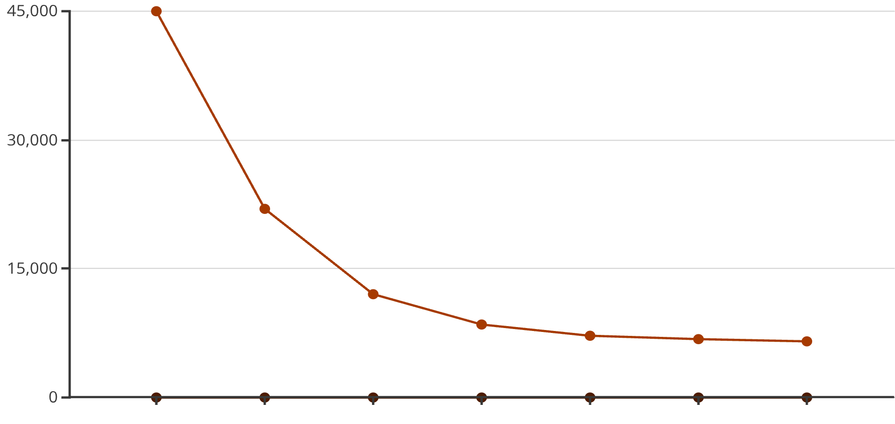
Determining Optimal K: Scree Plot Analysis
The Elbow Method
A scree plot visualizes the relationship between number of clusters (K) and total within-cluster sum of squares (WSS).
How to interpret:
Plot WSS against K values
Look for the "elbow" point where WSS decrease slows
The elbow indicates optimal K
Beyond this point, additional clusters provide diminishing returns
Number of Clusters (K)
Total WSS
In this example, the elbow occurs at K=3 or K=4, suggesting these as optimal cluster numbers for the dataset.
The scree plot helps balance model complexity with explanatory power, preventing over-segmentation.

Slide 20
Key Takeaways
Cluster Analysis Foundation
An unsupervised learning technique that groups observations into homogeneous clusters based on similarity, with objects within clusters being more similar than those between clusters.
K-Means Process
Iteratively assigns observations to nearest cluster centroids and recalculates centroids until convergence. Requires five key steps: define K, choose distance measure, select initial seeds, execute algorithm, and evaluate output.
Distance Metrics Matter
Euclidean distance is most common, but Manhattan and Chebyshev offer alternatives. The choice impacts cluster formation and should align with data characteristics.
Quality Assessment
Evaluate solutions using Total WSS (lower is better) and R-squared (higher is better). Use scree plots to determine optimal K through the elbow method.
Best Practices
Standardize variables, test multiple K values and initial seeds, apply dimensionality reduction when needed, and use dummy variables for categorical data.

